Slide 1

跨境養老十年經驗
探索大灣區養老的挑戰與機遇
Exploring the challenges and the opportunities of elderly care at Greater Bay Area with the past ten years cross border experience
香港復康會 The Hong Kong Society for Rehabilitation
署任總監(服務發展) Acting Director (Service Developments)
周惠萍女士 Ms. Phyllis CHAU
Email: Phyllis.chau@rehabsociety.org.hk

Slide 2
大綱
Agenda
1、跨境養老經驗 Cross-border Elderly Care Experiences
2、大灣區發展 Development of Greater Bay Area
3、跨境養老的機遇 Opportunities of Cross-border Elderly Care
4、跨境養老的挑戰 Challenges of Cross-border Elderly Care

Slide 3
1. 跨境養老經驗
Cross-border Elderly Care Experiences

Slide 4
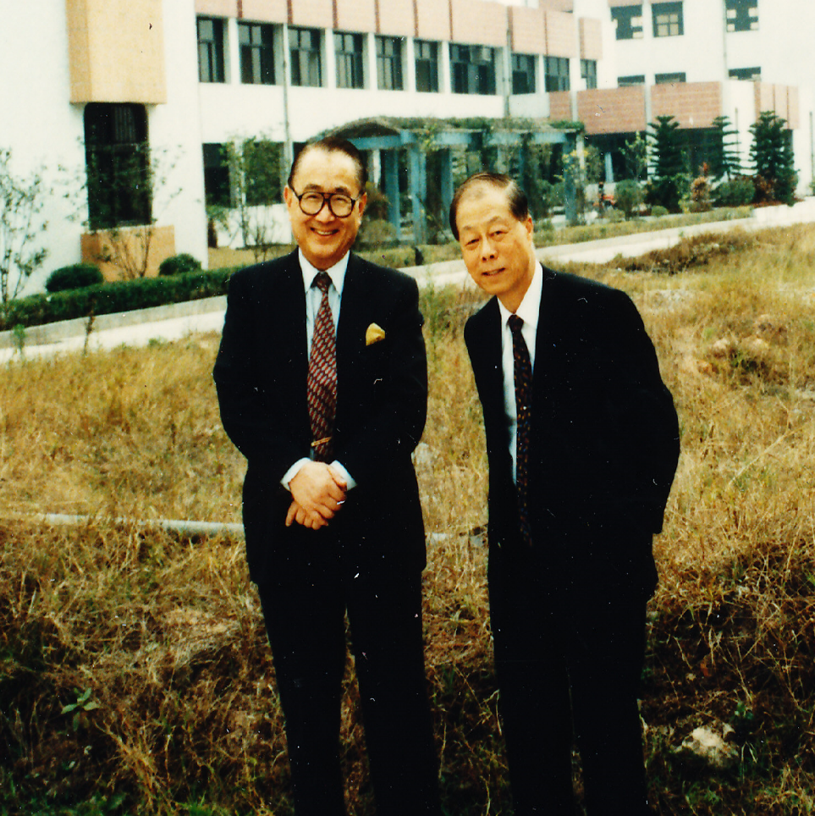
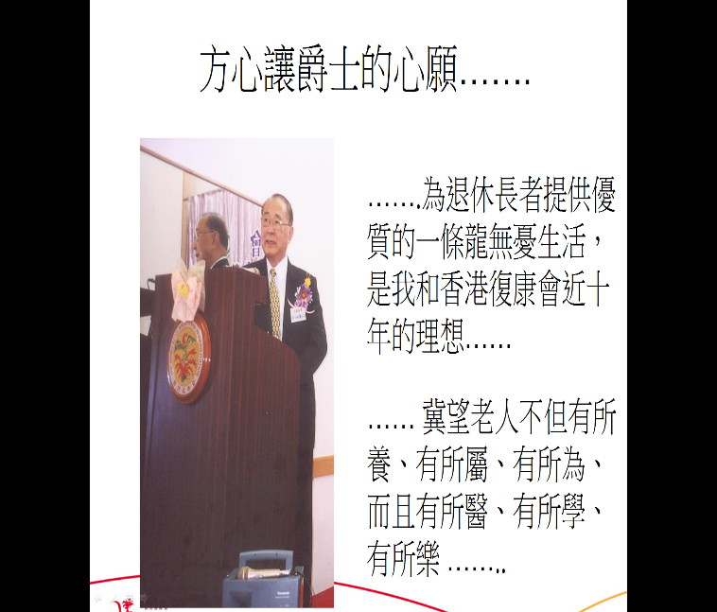
方心讓爵士和李文彬先生的心願 (2000年)
Dreams of Sir Harry Fang Sin-yang & Mr. Lee Man-ban
(Year 2000)
為退休長者提供優質的一條龍無憂生活，是我和香港復康會近十年的理想。
Having a dream to provide the quality, friendly, comprehensive residential and intensive rehabilitation service to the seniors.

Slide 5
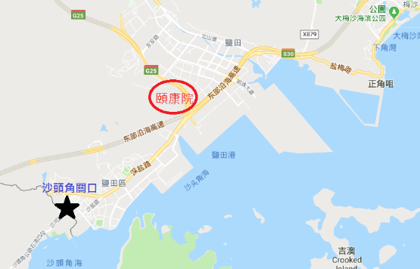

香港賽馬會深圳復康會頤康院
HKJC Shenzhen Society for Rehabilitation Yee Hong Heights
香港賽馬會慈善信託基金資助興建，
香港復康會營運管理
Construction and fitting was supported by
the Hong Kong Jockey Club Charities Trust,
managed by The Hong Kong Society for Rehabilitation.
位於深圳鹽田梧桐山半山，面向鹽田港口
Was built on a piece of land in the mid level
of Wutongshan (梧桐山), commands a panoramic view of the Yantian deep water port.

Slide 6
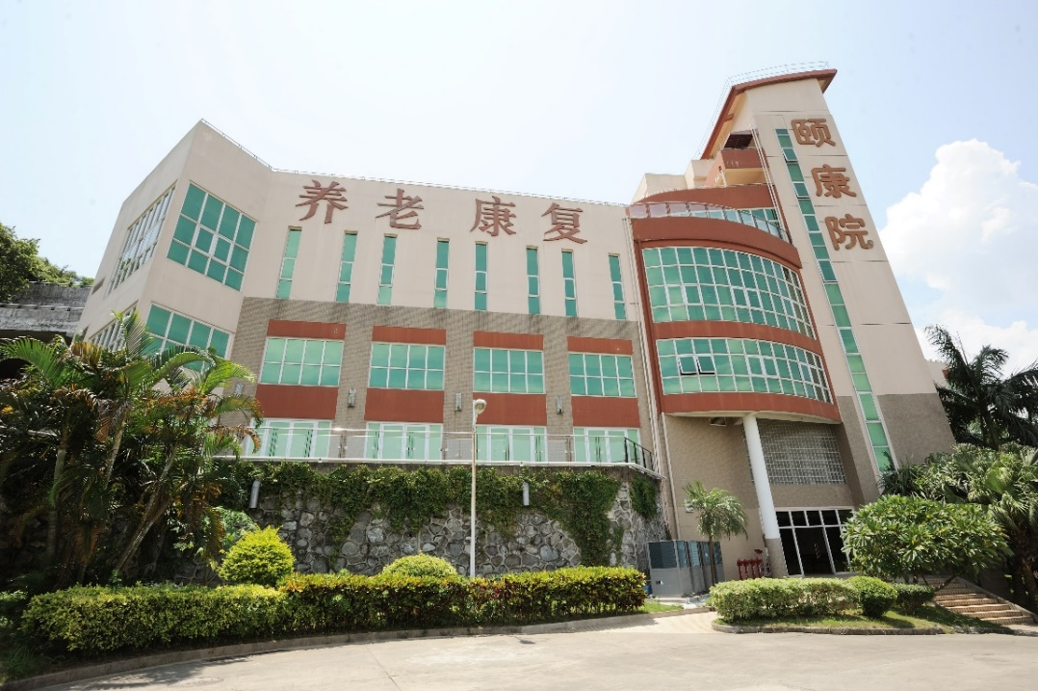
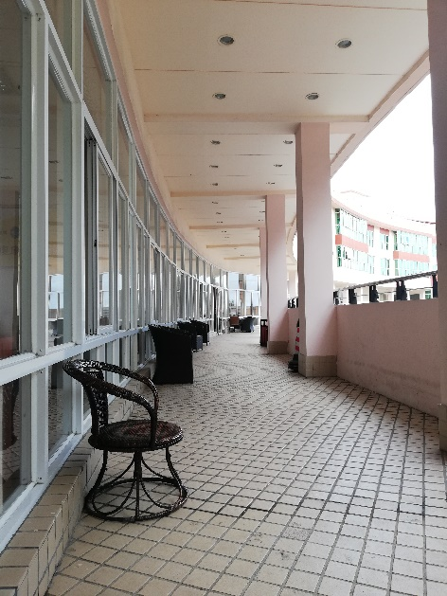
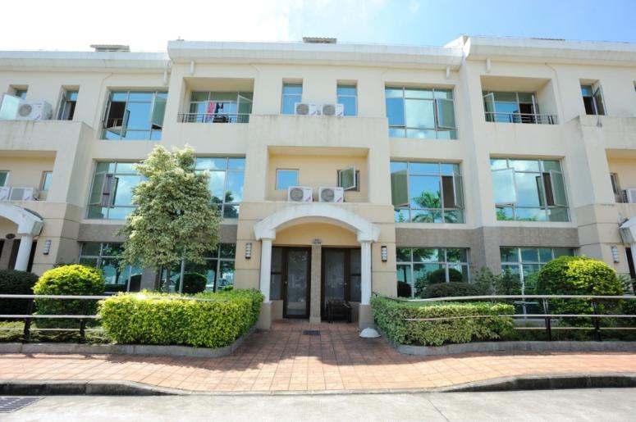
香港賽馬會深圳復康會頤康院
HKJC Shenzhen Society for Rehabilitation Yee Hong Heights
由2006年開始投入服務
Started service operation from 1 April 2006
融合護理、復康治療、適健及養生服務
Integrating residential nursing care, Chinese and Western rehabilitation therapy, wellness & longevity in services provided
可供入住總床位為315個
With a total capacity of 315 beds

Slide 7
頤康院里程 Milestones of Yee Hong Heights
2006年
獲廣東省民政廳頒發
《養老機構設立許可證批準證書》，開始營運
Licensed as a welfare home for the elderly by the Department of Civil Affairs of Guangdong Province.
2012年
取得香港老年學會
「香港安老院舍評審計劃」認證
Licensed under the Residential Aged Care Accreditation Scheme (RACAS) by the Hong Kong Association of Gerontology.
2013年
被內地媒體評價為中國
十大成功院舍之一
Evaluated as one of the China's
top ten successful home.
2014年
「廣東院舍住宿照顧服務試驗計劃」(簡稱買位計劃)
The Pilot Residential Care Services Scheme in Guangdong was implemented.
2018年
計劃與香港大學深圳醫院合作，提供外展醫療到診服務試驗
Attempt to collaborate with the University of Hong Kong –Shenzhen Hospital to provide outreach medical services as clinical trials.
2008年
獲深圳鹽田區衛生局核準醫療執業資格證，提供預防保健項目及康復醫療項目
Medical license was approved by the SZ Yantian District Health Bureau, providing preventive health care and rehabilitation medical projects.

Slide 8


輪候護理安老院的平均輪候時間
Average Waiting Time for Care and Attention Homes for the Elderly
3
津助院舍及合約院舍
37個月@2018
Subvented Homes and Contract Homes
37 months @2018
參與改善買位計劃的私營安老院
10個月@2018
Private Homes for the Elderly Participating in Enhanced Bought
Place Scheme
10 months @2018
資料來源：
香港特別行政區政府社會福利署網頁 https://www.swd.gov.hk/storage/asset/section/632/tc/LTC_Statistics_HP-Chi(201808).pdf
2) 安老事務委員會 「就長者住宿照顧服務所進行的顧問研究 最後報告」http://www.legco.gov.hk/yr09-10/chinese/panels/ws/papers/ws0111cb2-668-3-c.pdf

Slide 9


在輪候資助安老宿位時離世的長者人數 (2005-2017)
The numbers of elders who passed away while waiting for subsidized NH places and C&A places (2005-2017)
6,611人
(對比2005年上升95%)
@2017年
(increased by 95%) in year 2017,
comparing with year 2005
3,392人
@2005年
資料來源：香港特別行政區政府社會福利署網頁 https://www.lwb.gov.hk/chi/legco/04072018_4.htm

Slide 10

床位使用為94%，共297人
297 residents with a Bed Utilization rate of 94%
當中171為香港居民
171 of the residents are HK residents
最新院友數據
Latest statistics of Residents
6
*data as of 31 Oct, 2018

Slide 11

最新院友數據
Latest statistics of Residents
Male男 Female 女
128 169
6
*data as of 31 Oct, 2018

Slide 12

年齡分佈
Age distribution
50 or below

Slide 13


護理級別情況
Distribution of Care Level
Self-care
Additional
Special
Intensive

Slide 14
廣東院舍住宿照顧服務試驗計劃背景
Background of The Pilot Residential Care Services Scheme in Guangdong
2014年施政報告提出向兩間位於廣東省並由香港非政府機構營運的安老院舍購買宿位
In the 2014 policy address, the government proposed to purchase places from the two residential care homes in Guangdong province which were operated by HK non-government organizations.
政府自2014-15年度起已為試驗計畫預留約3,200萬元經常性撥款，以
提供400個宿位。實際開支會視乎入住長者的數目
The government has earmarked about $ 32 million in recurrent funding for the pilot project since 2014-15 in order to provide 400 places.
試驗計畫旨在為有意在退休後返回內地的本港長者提供選擇
Aims to provide options for the elderly in mainland after retirement.

Slide 15

計劃成效
Effectiveness of the Scheme
計劃自2014年6月推出至2018年9月，累計共有172名長者曾透過參與此計劃入住頤康院。
172 HK residents have been being the beneficiaries under the Pilot Residential Care Services Scheme in Guangdong as at Sep 2018, since the scheme was implemented in Jun 2014 .

Slide 16
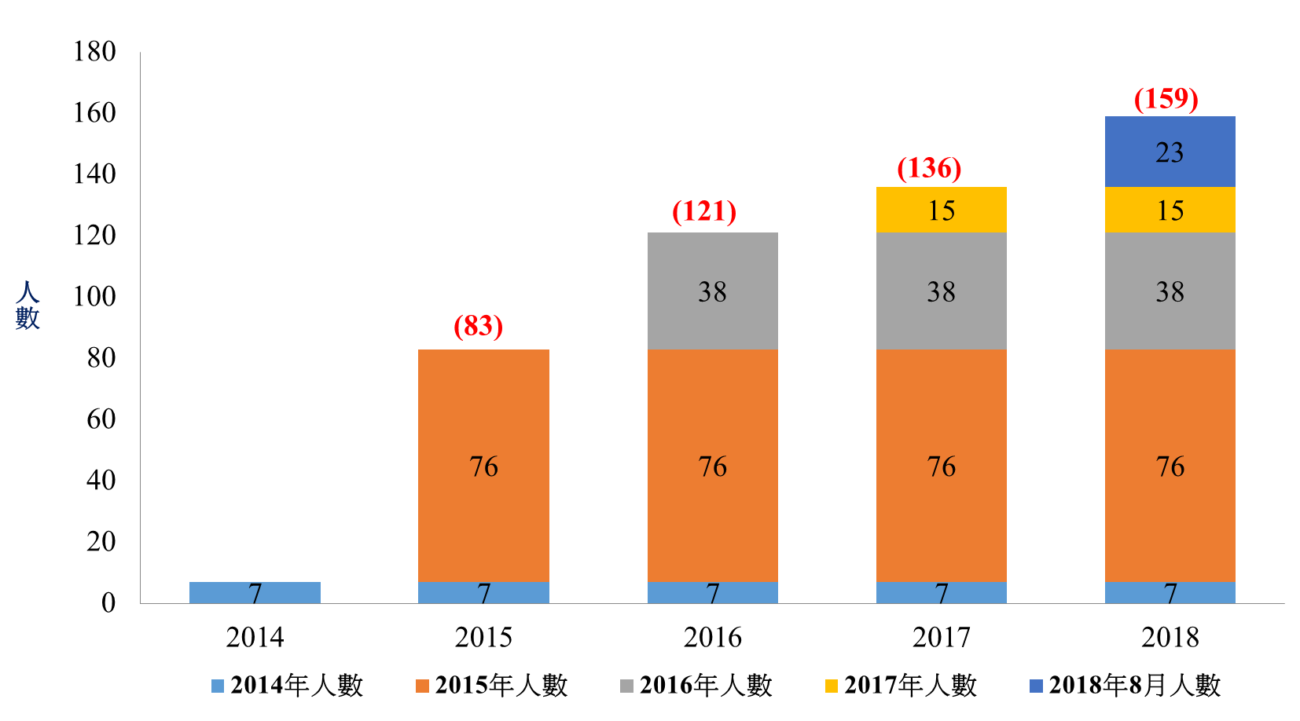
參加「廣東院舍住宿照顧服務試驗計劃」人數
Number of People joining
The Pilot Residential Care Services Scheme in Guangdong
(2014 – 2018.8)
(172)
(149)
28
28
(7)
2018年9月人數

Slide 17
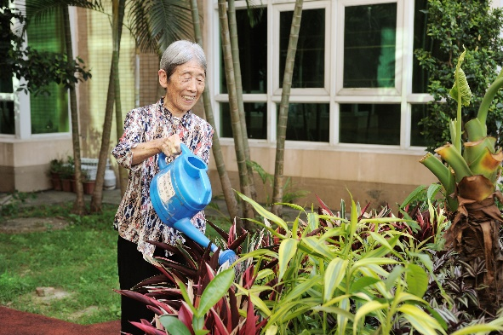
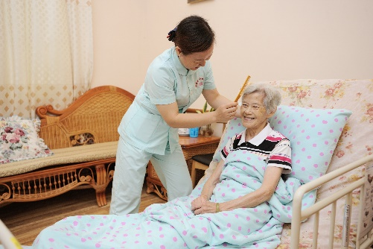

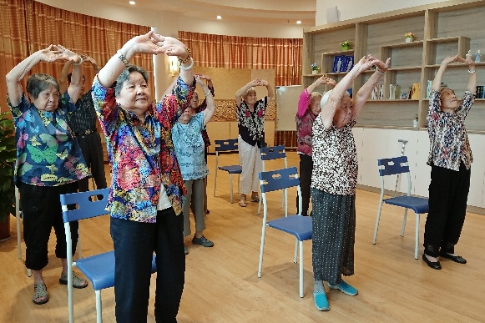
營運經驗分享 Sharing of Operation Experience
1. 入住自由度高，提供短住體驗，釋除疑慮
High flexibility and provides tasting experience via trial scheme
對香港的長者而言，他們可以自由選擇入住及退出。 頤康院亦有提供
9日8夜的短住服務，讓長者在決定入住之前有實在的體驗，能客觀地衡量自己是否適合使用本院。
Elders can choose to join or withdraw from our YHH, trial scheme
(9 days and 8 nights) allow the elders tasting their lives with us before they have their final decision to have long stay.

Slide 18
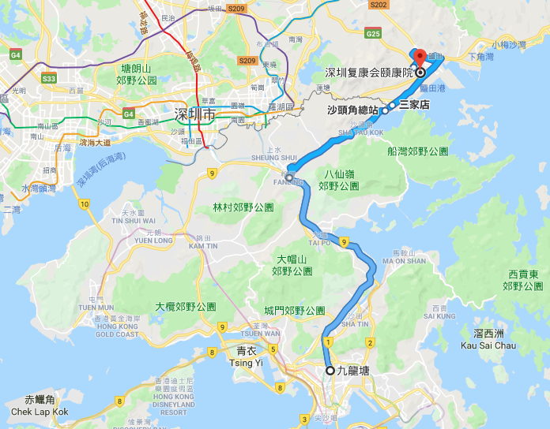

2. 地理位置鄰近香港，方便長者
Location is convenient and not far away from HK
在地理位置方面，頤康院位處深圳市鹽田區，位置鄰近香港，方便親友探訪長者或長者回港探親。（從九龍塘到頤康院車程約90分鐘）
Yee Hong Heights is adjacent to Hong Kong which is convenient for
the relatives and friends to visit the elderly or vice versa.
(About 90 minutes from Kowloon Tong to YHH）

Slide 19
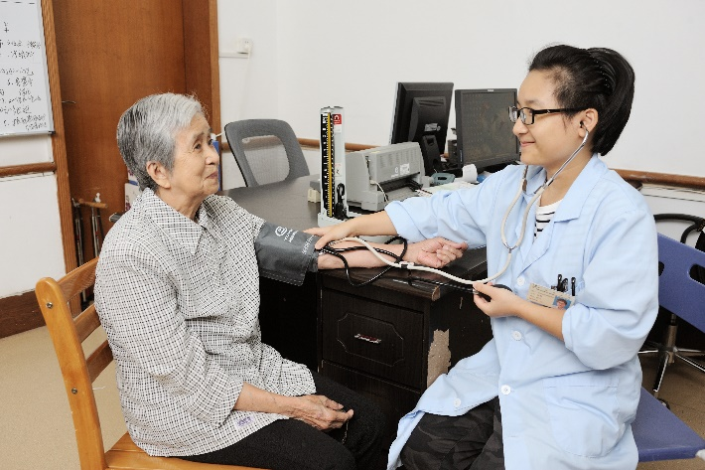
3. 醫療配套令長者安心
Medical support services for elderly
駐院醫生為院友提供基本健康診治及定期健康檢查
為院友提供跨境醫療服務，接載院友往返香港各區醫院覆診
參加「買位計劃」的長者更提供每年4次無障礙交通，接載院友往返香港新界區醫院或診所覆診
本院將與香港大學深圳醫院合作，提供外展醫療到診服務試驗，為長者提供多一個選擇
With in-house medical officers to provide medical consultation and regular health check-up for our residents
YHH also provides cross-border transportation to the elderly who prefer to have the medical consultation in Hong Kong
For those joined the Pilot Residential Care Services Scheme at Goungdong, their scheme includes free accessible transportation to and from the hospitals or the clinics located at the new territories area of Hong Kong 4 times a year
Besides, we will collaborate with the University of Hong Kong (HKU) Shenzhen Hospital to provide outreaching medical services for the elderly

Slide 20
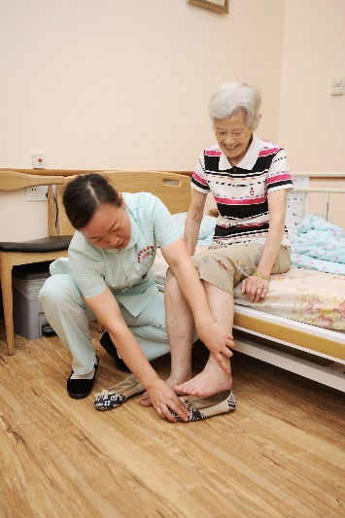


4. 為香港長者提供多一個選擇
Provide additional choice for the Hong Kong elderly
申請者經評估後便能在短時間內安排入住，能為有需要的長者提供多一個養老的選擇。
在中港兩地緊密發展下，計劃可取兩地優勢。內地地大物博，資源豐富；香港在長者持續照顧服務有豐厚的經驗，能提供高質素的管理及服務。
在協同效應下，可用較合理的成本提供相對優質服務，回應香港老年化現象的社會需求。
It takes just a short period of time for the assessment for the applicants of admission, so that the HK elderly can have one more option.
YHH can take the benefits of both Hong Kong and Mainland, the former has the experience and standards of quality of care while the latter has resources e.g. space and manpower.
Costs can be minimized by enjoying this synergy effect.

Slide 21
2. 大灣區發展
Development of Greater Bay Area (GBA)

Slide 22
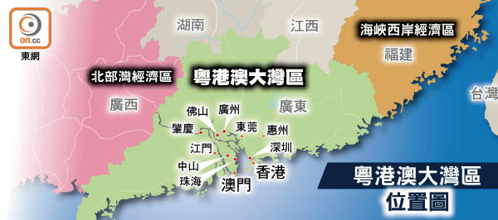
粵港澳大灣區概要
Overview of
Guangdong-Hong Kong-Macao Greater Bay
圖片來源:on.cc 東網
粵港澳大灣區(大灣區)範圍包括香港、澳門兩個特別行政區，和廣東省廣州、深圳、珠海、佛山、惠州、東莞、中山、江門、肇慶九市。
There are altogether 9 cities at the Greater Bay Area (GBA) including HK and Macao
大灣區建設的核心為發揮各城市的優勢，進一步深化粵港澳合作，促成區域內的深度、有機融合，推動區域經濟協同發展，將大灣區建設成宜居、宜業、宜遊的國際一流灣區。
The GBA concept is a kind of synergy of the cities at the bay area, so as to promote collaboration and integration of Guangdong-Hong Kong- Macao; so as to enhance the socio-economical development of all the cities, make it as a perfect place to live, to run business and to travel among the other bay areas over the world

Slide 23
大灣區規劃歷程 Development of Greater Bay Area
圖片及資料來源:立法會秘書處資料研究組
《粵港澳大灣區概況》 (2018)

Slide 24
世界主要灣區的相關數據及比較
Comparison of Bay Area over the World
(GD-HK-M vs Tokyo vs New York vs San Fransico)
圖片及資料來源:
立法會秘書處資料研究組
《粵港澳大灣區概況》 (2018)

Slide 25
3. 跨境養老的機遇
Opportunities of Cross-border Elderly Care

Slide 26
香港人口正急速步入高齡化，開發土地難有共識，住宿服務名額長期供不應求
Population is rapidly aging in HK. There are difficulties for the public in HK to reach consensus of the usage of land. Elderly residential services cannot meet the demand continuously
Demand
Supply
資料來源：安老事務委員會 (2016) “安老服務計劃方案”第51頁

Slide 27
2. 粵港澳地理上接近
Short Distance between Guangdong, Hong Kong and Macao
基建和交通將距離拉近，例如蓮塘關口、港珠澳大橋、深中通道等
Infrastructure and transportation shorten the distance,
e.g. Liantang Boundary Control Point, Hong Kong-Zhuhai-Macao Bridge, ShenZhen-ZhongShan Bridge
2018年8月國務院推出的港澳台居民居住證申領，豐富了粵港澳「一小時生活圈」的布局。
In the August of 2018, State Council of Central Government has launched
the Regulations of the Application of Residence Permit for Hong Kong, Macao and Taiwan Residents,
so that it enriched the “one hour living circle” at Guangdong, Hong Kong and Macao
圖片來源: 大公報(2017)
備註：在內地居住並符合資格的香港居民可申請領取居住證。持證人可在內地的居住地依法享有三項權利、六項基本公共服務及九項便利，涵蓋就業、教育、醫療、旅遊、金融等日常生活範疇
Remarks: A residence permit holder is entitled to enjoy, in accordance with the law, three categories of rights, six basic public services and nine facilitation measures in the place where he or she is residing, covering areas relating to daily living including employment, education, medical care, travel, financial services and so on
Press release of HKSAR: August 16, 2018

Slide 28


3. 中國及香港特區政府逐漸推出便民政策
Implementation of Government policies to encourage the elderly staying at Guangdong
2013年10月
「廣東計劃」
截至2018年7月31日，共有17,661人領取 。
Up to end of July 2018, there are 17,661 recipients of Guangdong Scheme
2014年7月
「廣東院舍住宿照顧服務試驗計劃」
目前共有2間香港非政府機構參與計劃，分別是
(1)香港復康會在深圳營辦的香港賽馬會深圳復康會頤康院
(2)伸手助人協會在肇慶營辦的香港賽馬會伸手助人肇慶護老頤養院
There are two Hong Kong NGOs joined the Pilot Residential Care Services Scheme of GuangDong since 2014:
HKJC Shenzhen Society for Rehabilitation Yee Hong Heights; and
The Hong Kong Jockey Club Helping Hand
Zhaoqing Home for the Elderly
圖片來源:社會福利署網頁、伸手助人協會網頁

Slide 29

3. 中國及香港特區政府逐漸推出便民政策
Implementation of Government policies to encourage the public staying at Guangdong
2015年10月
「長者醫療券香港大學深圳醫院試點計劃」
每名合資格長者每年可獲發的醫療券金額為港幣2,000元，每年未用完的醫療券金額可累積至其後年份使用，累積上限為港幣5,000元
The Elderly Health Care Voucher Scheme of the Government of the Hong Kong – can be pilot to use at the University of Hong Kong - Shenzhen Hospital
At present, the annual voucher amount per eligible elder is HK$2,000. The unspent voucher amount can be carried forward and accumulated for use in subsequent years, subject to a ceiling of HK$5,000.
2018《施政報告》提出:
把長者生活津貼擴展至廣東和福建兩省，向合資格長者每月發放該津貼
（包括普通額和高額津貼）
The CE Policy address in 2018:
To further facilitate Hong Kong elderly persons who choose to reside in Guangdong and Fujian, the Government will extend the Old Age Living Allowance to the two provinces to provide monthly payment (including Normal and Higher allowances) for eligible elderly persons.
圖片來源:社會福利署網頁、伸手助人協會網頁

Slide 30



4. 越來越多私營服務提供者在大灣區開辦養老和醫療服務，形成討論熱點
More and more private institutions have started to provide Elderly and Medical services in Greater Bay Area
圖片來源: 無線電視、蘋果日報、Now新聞

Slide 31

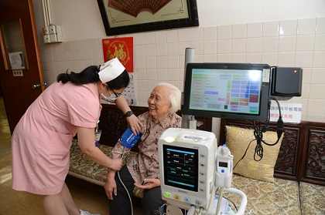

5. 科技取替護理人手
Technology to substitute nursing manpower
香港特區政府將預留10億元成立「樂齡及康復創科應用基金」，資助約1200個安老服務單位試用及購置科技產品，以推動樂齡科技，改善長者的生活。
The Government earmark $1 billion for setting up
a Innovation and Technology Fund in Elderly and Rehabilitation Care to subsidize elderly service units
to trial use and procure technology products,
in order to promote geron-technology for improving the quality of life of elderly persons and
enhancing the quality of elderly services by reducing the burden and pressure of carers and care staff.
圖片來源:eduplus.hk

Slide 32
4. 跨境養老的挑戰
Challenges of Cross-border Elderly Care

Slide 33

1. 香港政治氛圍不認同/支持跨境養老
Non-supportive political environment of Cross-border Elderly Care
  前立法會議員王國興 「鼓勵長者到大灣區安老的說法令人反感……」
  There are people feeling disguised when encouraging the HK elderly to live at Greater Bay Area
  將長者送到大陸生活好像日本電影 《猶山節孝》自生自滅，是 「次一」 的選擇
  Sending elderly to Mainland for their rest of the lives seems to be a kind of abandon, a less prioritized choice
  (星島日報9/9/2018)

Slide 34

2.香港長者心理上仍未完全接受跨境養老
Hong Kong Elderly are not comfortable with Cross-border Elderly Care
    從剛回歸政府的「三不」 (不支持、不反對、不參與) 到近期積極推動大灣區融合，長者認為政府在推銷一些 「次貨」， 需要時間適應和接受
    Elderly regards HK Government actively promoting cross border care recently seems to be “selling” something at the“lower class”, they may need time to digest
    長者在持續照顧服務上的需要不只是住宿和醫療，還有其他例如安全感、社區聯繫、友伴等支持
    Elderly needs sense of security, community connection, peer support instead of merely residential and medical services

Slide 35




3. 醫療配套尚未完善
Inadequate Medical Support
港人對內地醫療質素未有信心
內地醫療費用對港人來說負擔沉重(全自費)
醫療劵使用點受限制
藥物種類與香港有差異
Lack of confidence towards the medical care at Mainland
The medical expense (private charges) at mainland is heavy for HK residents
There are constraints in accepting the medical vouchers in mainland
There are differences for the medicine prescribed in HK and mainland

Slide 36
4. 可攜性福利受限
Limitation of the Cross-border Welfare Benefits
    可攜性綜援，過去 10 年間的綜援長者個案數目，累跌了 58% 至 2017 年的 1,399 宗，下跌原因有與 「回港就醫」和較香港領取的金額少很多有關
    For the protable CSSA, it dropped for 58% over past ten years to 1,399 cases in 2017. This may be probably because people preferred returning to HK because of the medical concern
    現時香港綜援每月獲發放金額連同特別津貼可達港幣10,000元，但可攜性綜援受助者每月最多只能領3,700左右。 (未來將有改善，2018《施政報告》提出把長者生活津貼擴展至廣東和福建兩省，向合資格長者每月發放該津貼（包括普通額和高額津貼）
    The highest amount of the Comprehensive Social Security Allowance in HK is about HKD 10,000 comparing to the portable Comprehensive Social Security Allowance taken at Mainland which is around HKD3,700 only.

Slide 37

5. 內地養老人才短缺
Shortage of Manpower for Elderly Services
《2017年中國養老服務業發展年報（人才篇）:
目前持證養老護理人員不足 2 萬人，而需求量至少為 15 萬人，缺口 13 萬
There are less than 20,000 certificated nursing & caring staff for elderly, but it is estimated to have a great demand of 150,000 people; hence there is a shortage of 130,000 people

Slide 38
參考資料 Reference
香港特別行政區政府社會福利署網頁 https://www.swd.gov.hk/storage/asset/section/632/tc/4.Provision_of_RCHEs_(Subsidised_versus_Non-subsidised_Places)(30.6.18)chi.pdf
經濟日報：29/5/2018
廣東省民政廳副廳長王長勝 (2017) 。《廣東省養老服務體系面臨的挑戰和機遇》
安老事務委員會 (2016) 。 《安老服務計劃方案》
香港政府統計處(2011) 。《綜合住戶統計調查》
立法會秘書處資料研究組(2018) 。《粵港澳大灣區概況》
政制及內地事務局網頁(有關大灣區發展)。https://www.bayarea.gov.hk/
香港特別行政區行政長官2018施政報告
北京師範大學中國公益研究院(2017) 。 《2017年中國養老服務業發展年報（人才篇） 》
謝謝! Thank you !

